Slide 1
Welcome to the Common Application
1 application, over 500 colleges
commonapp.org

Slide 2
Go to Commonapp.org
Click here to create an account

Slide 3
Create an Account *use an appropriate email address that you check often, remember, college representatives will see this! *take note of the password requirements listed at the bottom right

Slide 4
Create your account
All students should check “first year student” on the bottom left
All students should also check “applicant planning to enroll within the next 12 months” on the top right

Slide 5
Common App Dashboard
Note your common app ID above
Click the “my colleges” tab & then click on “college search”

Slide 6
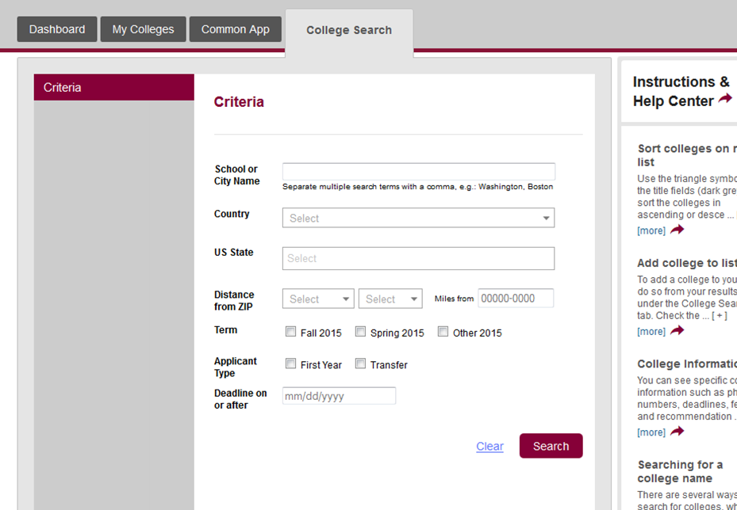
Use the search tool to add the colleges you plan to apply to

Slide 7
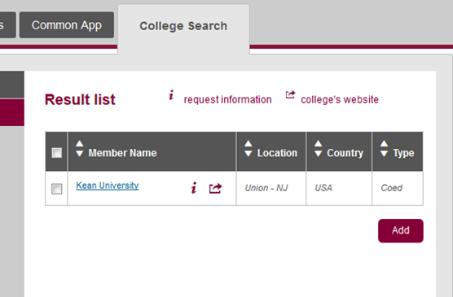
Your colleges will appear in the “Results List,” check the box to the left of your school and click “Add” to add the colleges to your Common App

Slide 8
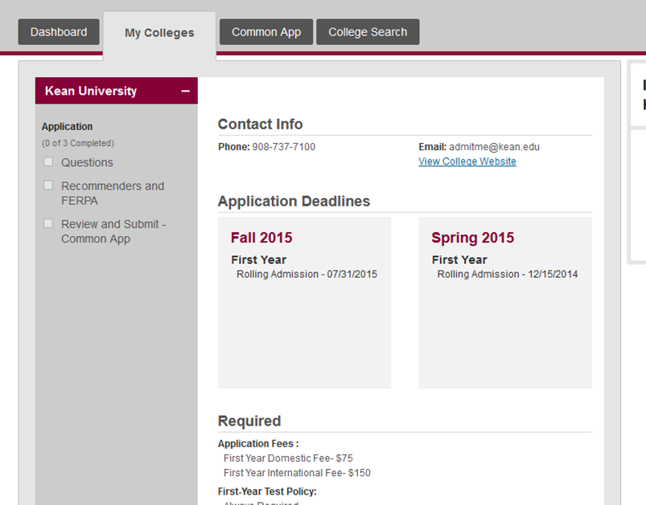
Go back to the “My colleges” tab and you will notice that Kean has been added
Note the admissions deadline

Slide 9
Adding colleges will also list your colleges under the “Dashboard” tab
You can keep track of your application progress on the dashboard
Click on the dashes & dot for more information

Slide 10
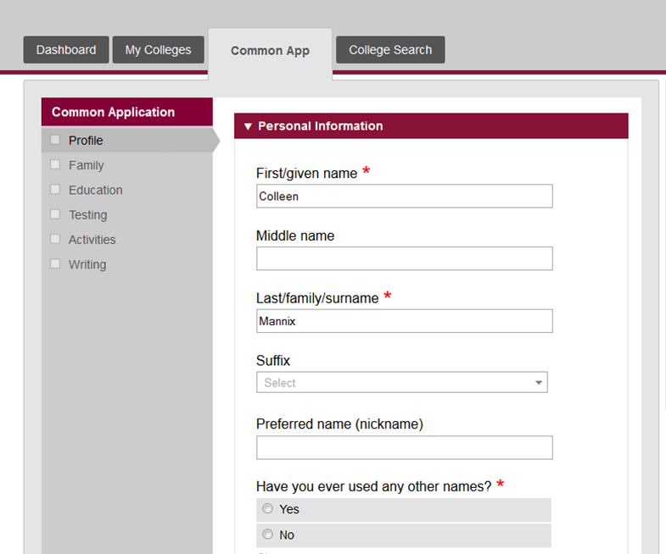
When you have the opportunity, go to the “Common App” tab and complete all of the requested information
A green check mark will appear in each section box once the section has been successfully completed

Slide 11
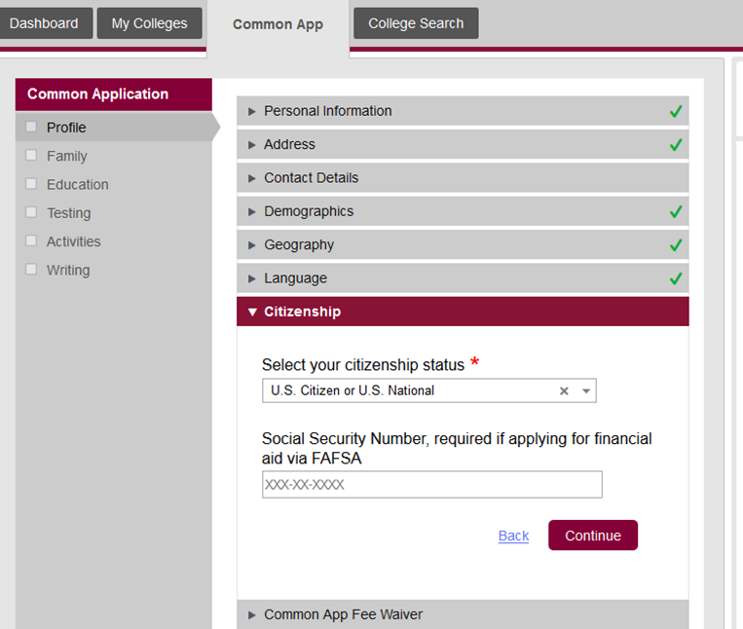
IMPORTANT: YOU MUST INCLUDE A SOCIAL SECURITY NUMBER TO BE CONSIDERED ELIGIBLE FOR FINANICAL AID!!! NON-CITIZENS WILL ONLY BE ELIGIBLE FOR MERIT AID

Slide 12
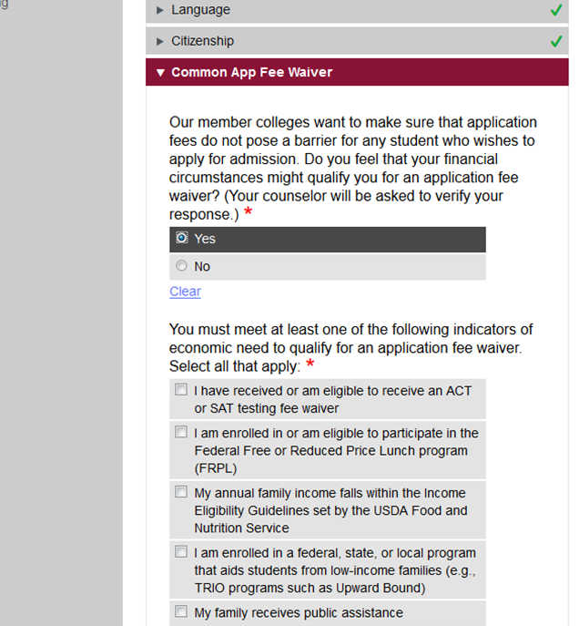
If you receive free or reduced lunch & used a fee waiver for the SAT/ACT you are eligible for 4 Common App Waivers
If eligible for a fee waiver, check all that apply

Slide 13
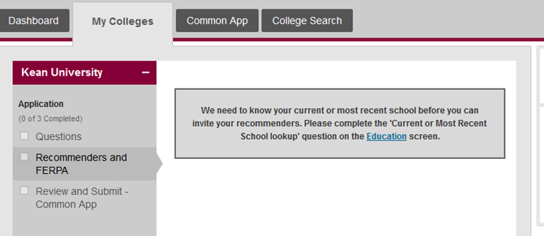
FERPA WAIVER: YOU ARE ASKED TO WAIVE YOUR RIGHT TO SEE YOUR RECOMMENDATIONS

Slide 14
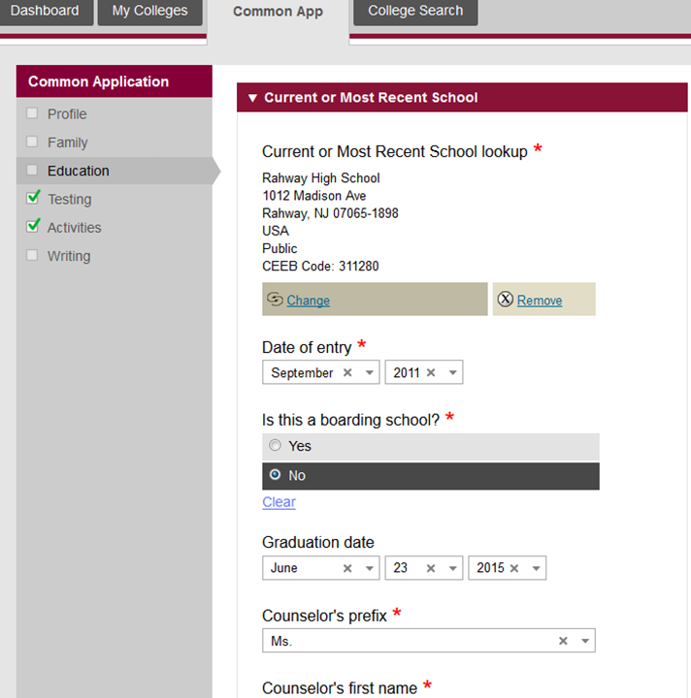
Enter your school information
date of entry
graduation date
Counselor name & contact information:
Mrs. Baumann
mbaumann@rpsd.org
908-241-4550 x2057
Mrs. Matarredona
amatarredona@rpsd.org
908-241-4550 x2054
Ms. Borkowski
cborkowski@rpsd.org
908-241-4550 x2056
Roselle Park High School
185 Webster Avenue
Roselle Park, NJ 07204
USA
Public
CEEB Code: 311330
2015
20
2019

Slide 15
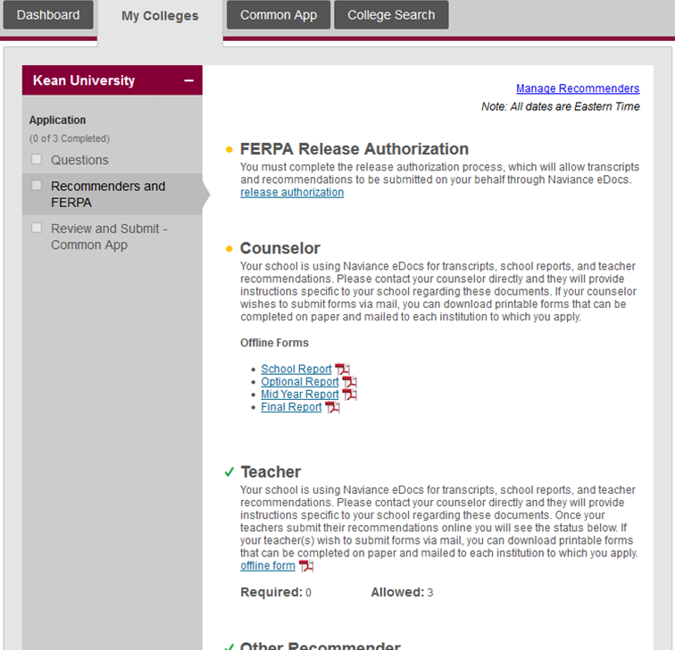
You will need to sign the FERPA release & link your Common App with Naviance– if this step is not completed, counselors cannot send your transcripts!
Click “release authorization,” follow the prompts and sign

Slide 16
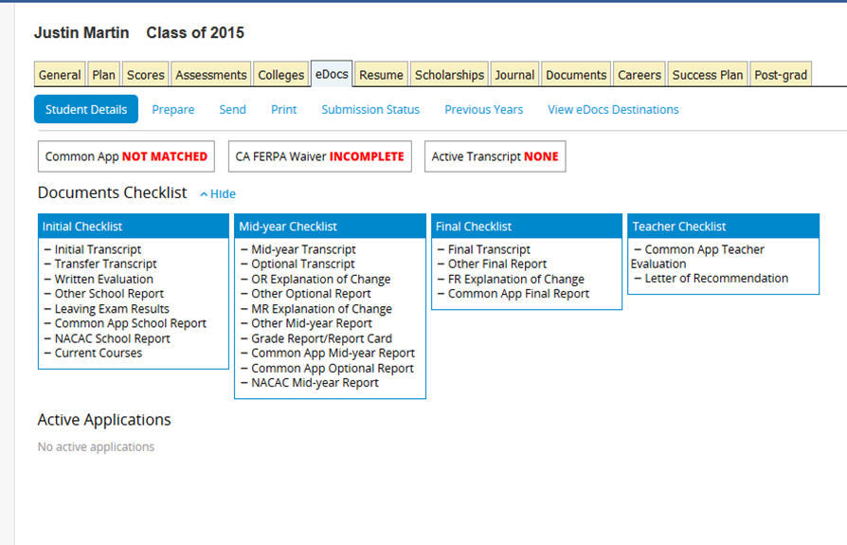
Naviance & Common App need to communicate!
Here’s how you will link the two for the transfer of your transcript and recommendation letters.
Log-in to your Naviance account
Click on the “college tab,” then click “college home,” “colleges I’m applying to” and complete the requested information to match your accounts.

Slide 17
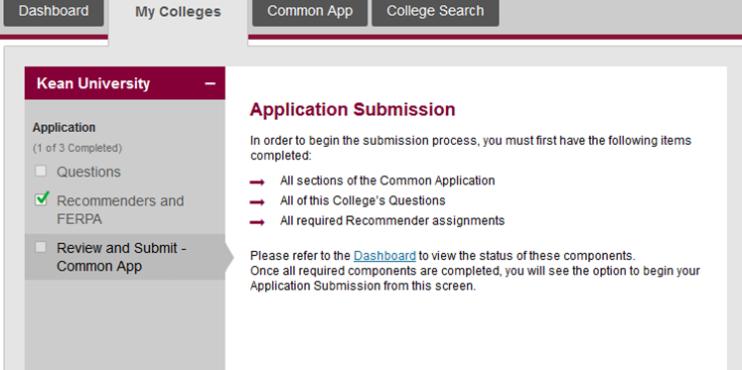
Review & Submit
Once you have completed all the components of the common app for a particular school and your recommendations have been submitted, you will click on “Review and Submit.” Check your application for accuracy and submit it. Guidance advises that you submit your application at least 1 week ahead of the deadline.

